Slide 1
Creighton Edington
Robotics Merit Badge

Slide 2
Before we start, documentation
“The Only Difference Between Screwing Around and Science Is Writing It Down“
Alex Jason
Your Engineering Notebook
Your Name on the cover
Treat it with care

Slide 3
Robot?
1: a machine that resembles a living creature in being capable of moving independently (as by walking or rolling on wheels) and performing complex actions.
2: a device that automatically performs complicated, often repetitive tasks.
3: a person who resembles a machine in seeming to function automatically or in lacking normal feelings or emotion.

Slide 4
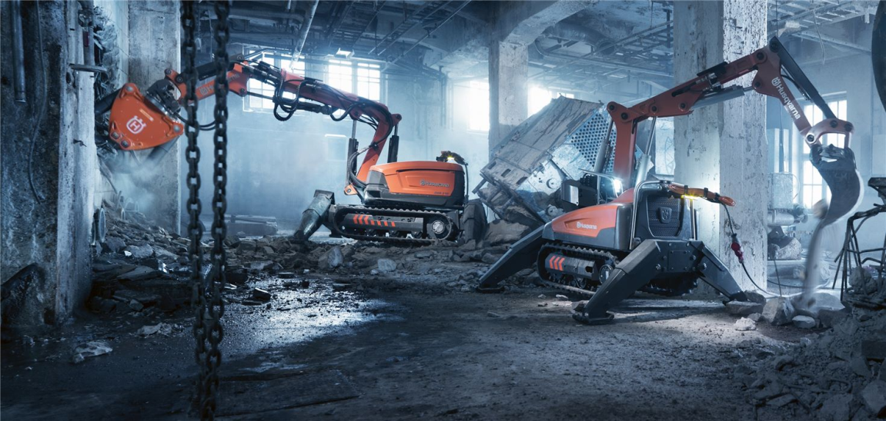

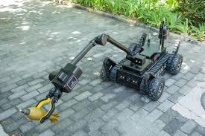
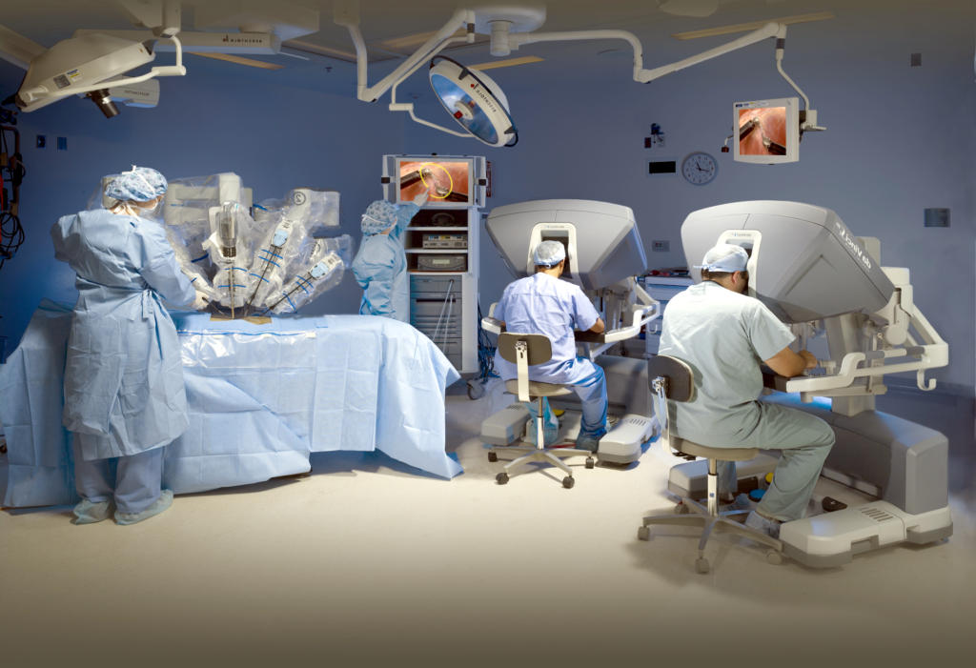
Dirty, Dull, Dangerous, Delicate, and/or Difficult, and Dollars

Slide 5
Safety
Hazards?
Anticipate, mitigate, and/or prevent
Safety gear and clothing?
First aid?

